Slide 1




TECHNICAL STUDY
DIGITAL TWINS
Amaury FUMARD – Xhesika LACI
Ayman EL MANNOUY
Sylvain Vauttier
Christelle Urtado
Gwendal Beaumont
source image : https://certi.org.br/blog/digital-twins-o-que-e-e-quais-os-impactos-nos-negocios/

Slide 2
Summary
3
INTRODUCTION TO DIGITAL TWINS
7
AIM OF THE TECHNICAL STUDY
8
REPOSITORY SCRAPPING
12
DATA ANALYSIS
18
CONCLUSION
V1.2 I PresentationI Frebruary 2025
2

Slide 3
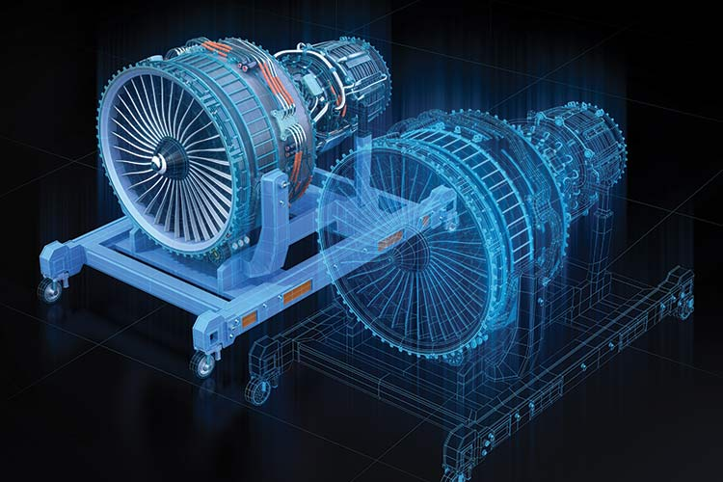
What is a digital twin?
A Digital Twin is an organized set of digital models representing a real-world entity updated in relation to reality at an adapted frequency and precision.
It can be used to optimize, simulate and predict performance.
AIF - http://www.industrie-dufutur.org/content/uploads/2023/05/AIF_JumeauNumerique_FR-version-Web.pdf
V1.2 I PresentationI Frebruary 2025
3
https://www.ptc.com/fr/industry-insights/digital-twin

Slide 4
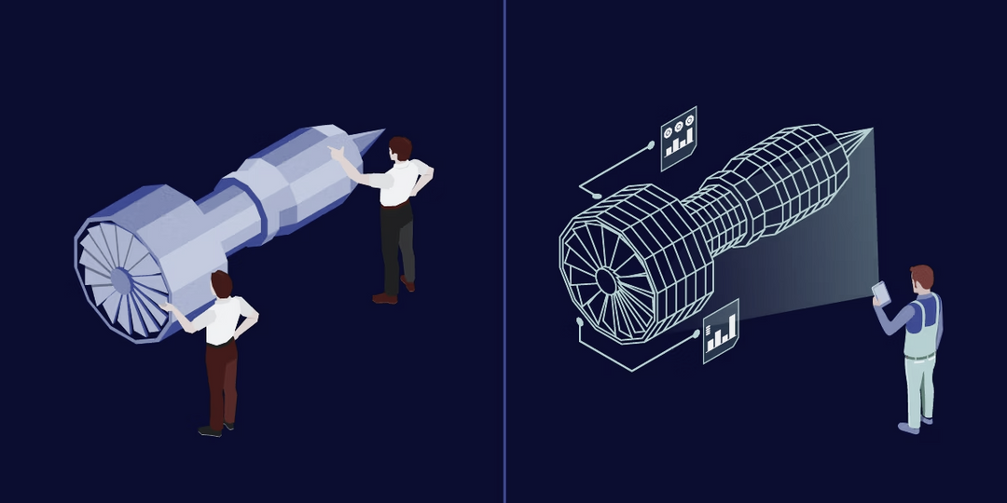

What is a digital twin?
THREE KEY POINTS
Real physical object
Real-time data connection
Digital twin
Industrial machine, building, vehicle, human body...
+
IoT sensors that collect data continuously.
IoT sensors and communication networks
+
Big Data and AI for predictions and decisions
Computer model (2D, 3D or based on advanced simulations)
+
Updated in real time with real-world data
+
Control action on real object
V1.2 I PresentationI Frebruary 2025
images source : https://www.teamviewer.com/fr-mea/insights/exploring-digital-twins-the-future-of-digital-transformation/?
4

Slide 5
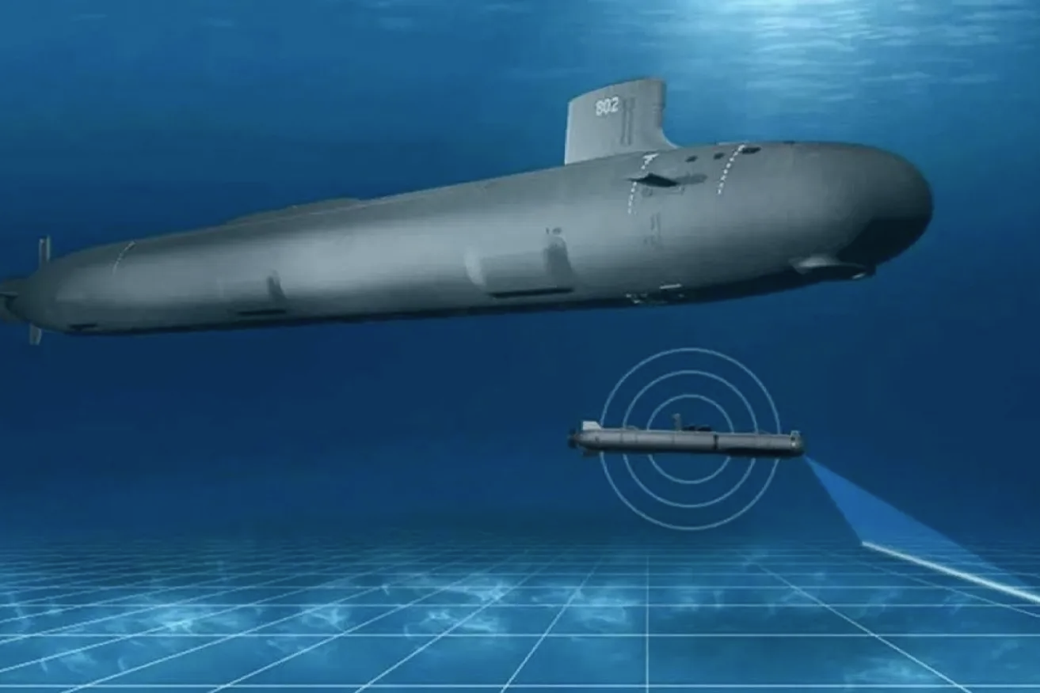



Example:
Submarine drone
A topical and particularly interesting subject
PHYSICAL OBJECT
DATA CONNECTION
DIGITAL TWIN
Extreme/dangerous condition that limits communication
+
Complex and costly technology
A lot of complex metrics
+
Connection that depend from context
Many possible scenarios when contact is lost
+
Several different usage contexts
https://www.indaily.com.au/news/science-and-tech/2023/12/19/the-devilishly-difficult-needs-of-naval-drones
V1.2 I PresentationI Frebruary 2025
5

Slide 6

✨​ BENEFITS
🏔️ ​CHALLENGES
Economy and safety
Complexity and cost
Predictive maintenance
Massive data volumes
Reducing downtime
High initial investment
Optimizing resources
Specialized skills required
Advanced simulations
Need for standardization
Virtual tests
Interoperability issues
Accelerated development
Lack of reference architecture
V1.2 I PresentationI Frebruary 2025
6

Slide 7
Aim of the technical study
FIND AND DEFINE THE FOUNDATIONS OF A COMMON BASE FOR EMERGING DIGITAL TWIN TECHNOLOGY
Our objectives :
Create a database of existing projects
Scrap repositories from GitHub
Scrap repositories from Software Heritage
Merge and synchronize the resulting data
Merge and synchronize the resulting data
Complete and analyze the data retrieved
Complete and analyze the data obtained
Identify and target important data
Use analytical resources to process our data
Identify trends in the development of digital twins
V1.2 I PresentationI Frebruary 2025
7

Slide 8



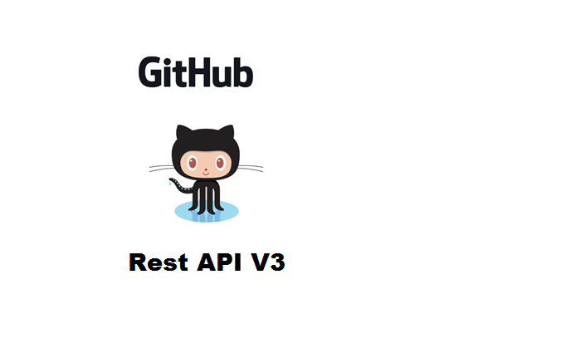

Repository scrapping
1 - GitHub
📌 Search GitHub repositories
“digital twin” request
Retrieves up to 1000 results (GitHub limitation)
📌 Save data as CSV
1000 GitHub URL
V1.2 I PresentationI Frebruary 2025
8

Slide 9

Repository scrapping
1.2 - takle GitHub difficulties
Create a short list of keywords related to digital twins
Generate new keywords using DeepSeek
Search for repositories in github
Digital twin
LLM
Virtual Representation
Big database of ~90.000 URL
~350 keywords
ISO 23247
a delay is used whenver the limitation is reached
❗needs additional filtering
Number of keywords:
11
V1.2 I PresentationI Frebruary 2025
9

Slide 10


Repository scrapping
2 - Software Heritage (SH)
📌 Search SH repositories
“digital twin” request on meta-data
No result limitation
📌 Save data as CSV
1400 SH URL
V1.2 I PresentationI Frebruary 2025
10

Slide 11


Repository scrapping
3 - Merge and synchronize the resulting data
📌 Identify duplicates between GitHub and Software Heritage
22 joint projects between the two databases
22 joint projects between the two databases
📌 Extracting GitHub URL from Software Heritage projects
Retrieving GitHub URL
Check that repositories are still accessible
740 new GitHub repositories recovered and added to the CSV
V1.2 I PresentationI Frebruary 2025
11

Slide 12
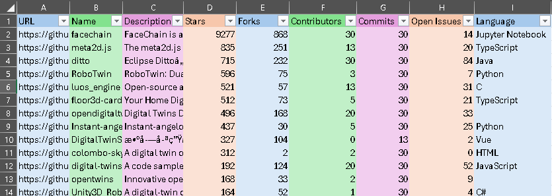
Data analysis
1 - Identify and target important data
URL
Name
Description
Stars
Forks
Contributors
Commits
Open Issues
Language
V1.2 I PresentationI Frebruary 2025
12

Slide 13


Data analysis
2 - Use analytical resources to process our data
V1.2 I PresentationI Frebruary 2025
13

Slide 14
Data analysis
3 - Results
 | Stars | Forks | Contributors | Commits | Open Issues
Count | 1740.0 | 1740.0 | 1740.0 | 1740.0 | 1740.0
Mean | 12.8 | 2.9 | 1.9 | 13.2 | 1.7
Std Dev | 226.1 | 23.8 | 2.7 | 11.7 | 7.8
Min | 0.0 | 0.0 | 0.0 | 0.0 | 0.0
25% | 0.0 | 0.0 | 1.0 | 2.0 | 0.0
50% | 1.0 | 0.0 | 1.0 | 8.0 | 0.0
75% | 3.0 | 1.0 | 2.0 | 29.0 | 0.0
Max | 9277.0 | 868.0 | 30.0 | 30.0 | 170.0
V1.2 I PresentationI Frebruary 2025
14

Slide 15
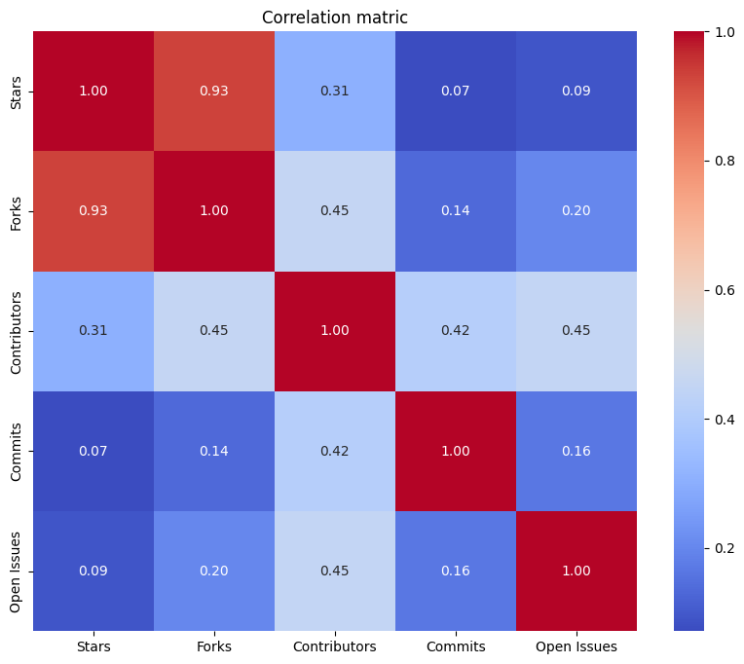
Data analysis
3 - Results
V1.2 I PresentationI Frebruary 2025
15

Slide 16
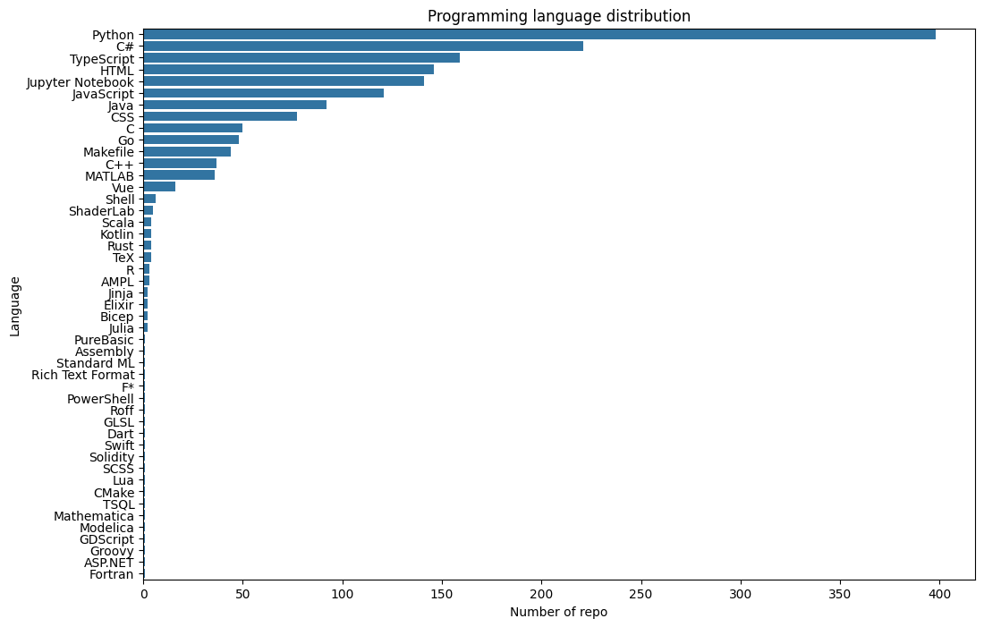
Data analysis
3 - Results
V1.2 I PresentationI Frebruary 2025
16

Slide 17
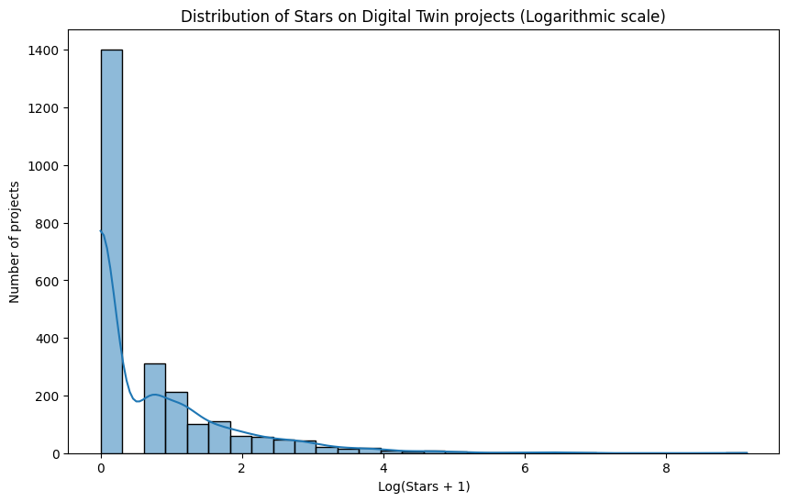
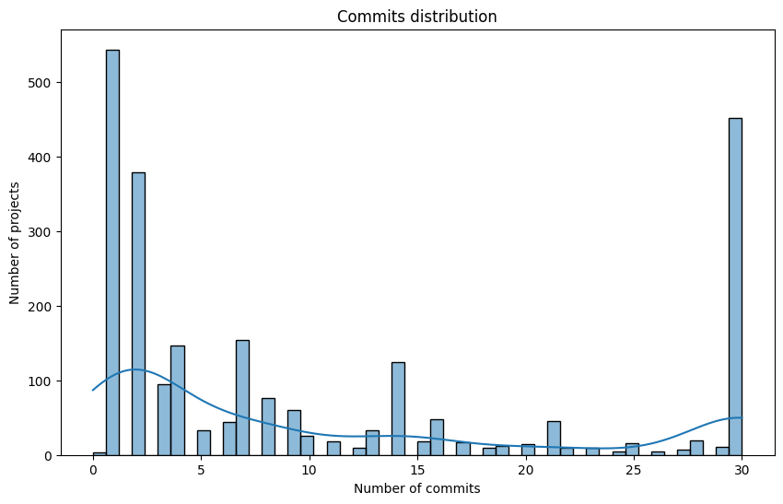
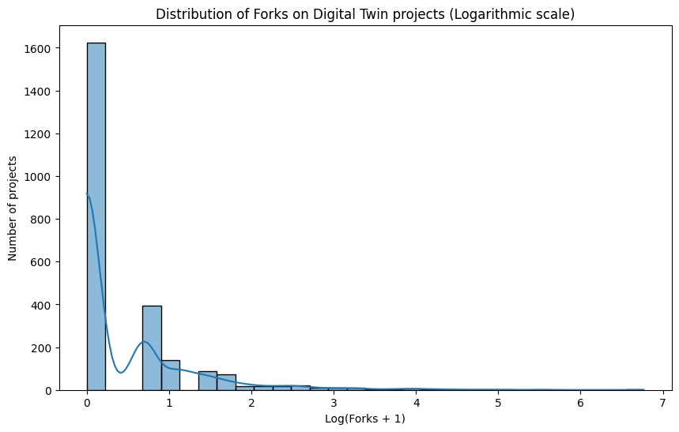
Data analysis
3 - Results
V1.2 I PresentationI Frebruary 2025
17

Slide 18
Conclusion
RESULTS
Create a database of existing projects
✔️ Scrap repositories from GitHub
✔️ Scrap repositories from Software Heritage
✔️❕ Merge and synchronize the resulting data
Complete and analyze the data retrieved
✔️❕ Identify and target important data
✔️ Use analytical resources to process our data
✖️ Identify trends in the development of digital twins
V1.2 I PresentationI Frebruary 2025
18

Slide 19
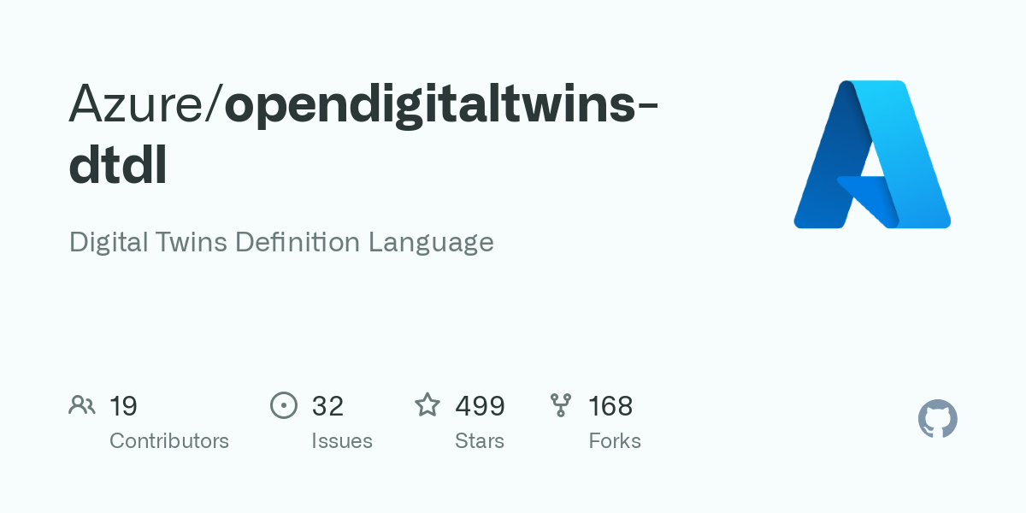
Conclusion
OUTLOOKS
Get more data from GitHub
from more repositories
tags, type of contributor...
Find a way to standardize projects to make them comparable
➡ convert to DTDL
V1.2 I PresentationI Frebruary 2025
19

